Slide 1
Welcome to
Our Sunday School
We’ll start at 9:07
visit OurSundaySchool.com for more about our class

Slide 2
Today’s class (pages 65-70)
Philippians 1:18-19a

Slide 3
Philippians 1:18-19a (CSB)
What does it matter? Only that in every way, whether from false motives or true, Christ is proclaimed, and in this I rejoice. Yes, and I will continue to rejoice because I know this will lead to my salvation through your prayers and help from the Spirit of Jesus Christ. My eager expectation and hope is that I will not be ashamed about anything, but that now as always, with all courage, Christ will be highly honored in my body, whether by life or by death.

Slide 4
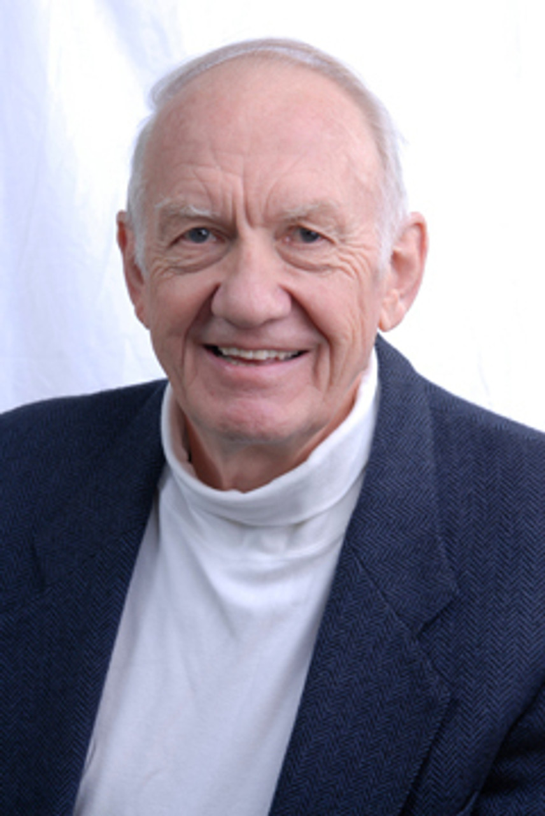
Dr. Gordon Fee Here is one for whom the gospel is bigger than his personal role in making it known.

Slide 5
Today’s class (pages 65-70)
Philippians 1:18-19a

Slide 6
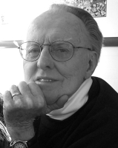
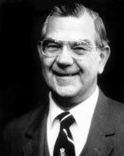
Dr. G. F. Hawthorne & Dr. Ralph P. Martin The how of preaching is not the object of Paul’s joy; the fact of the preaching is. For when the word of God is preached, it overcomes all hindrances…

Slide 7
Dr. G. F. Hawthorne & Dr. Ralph P. Martin and moves on to its goal; its contents are irresistible.... The power of the gospel, therefore, does not depend on the character of the preacher.

Slide 8
Today’s class (pages 65-70)
Philippians 1:18-19a

Slide 9
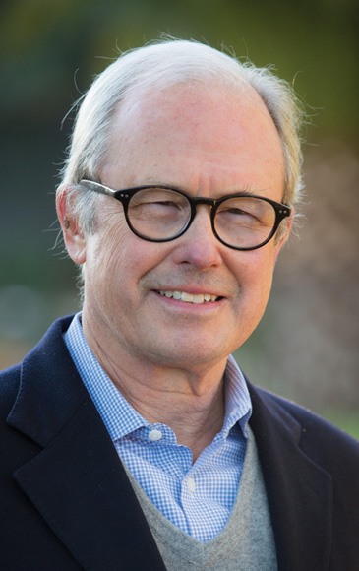
Dr. G. Walter Hansen The advancement of the message, not the advancement of Paul, is the source of Paul’s joy.

Slide 10
Today’s class (pages 65-70)
Philippians 1:18-19a

Slide 11
Dr. G. Walter Hansen Whether he lives or dies, whether he is executed or released, Paul is determined to rejoice. The prospect of his trial drove him to prayer, but it did not drive him to despair…

Slide 12
Dr. G. Walter Hansen His joy did not depend on the prospect of keeping his life, but on honoring Christ, whether by life or by death…

Slide 13
Dr. G. Walter Hansen Paul’s decision to rejoice whether he lived or died was not completely irrational. His joy was based on knowledge, the knowledge of his deliverance.

Slide 14
Today’s class (pages 65-70)
Philippians 1:18-19a

Slide 15
Prayer Time
Write down your prayer requests (on the Weekly Update or in the comments)
Lean in, engage, and pray for someone not with you
Go worship

Slide 16
Today’s class (page 16)
Preparing for Philippians 1:1-30
Pray with others
Hear with others
Think with others
Study with others In class, as a table
Share with others
Invite others After class
In class, as a class

Slide 17
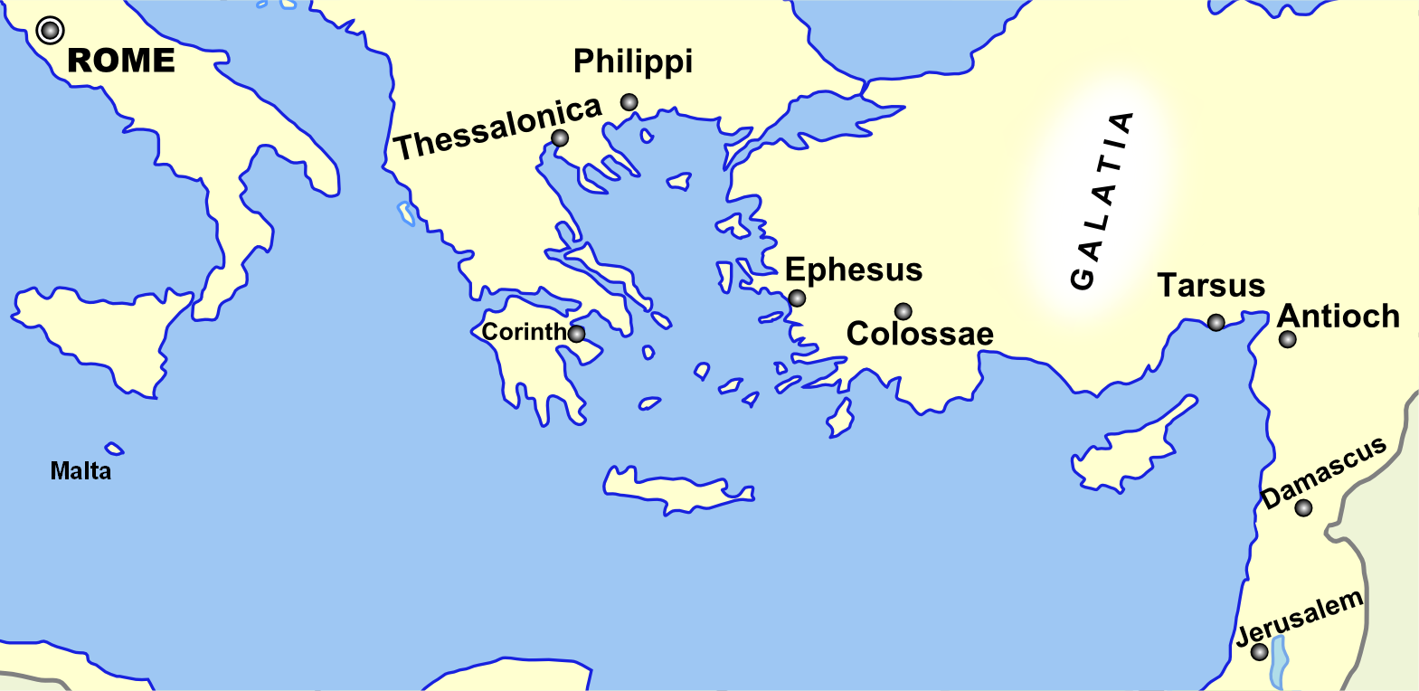
Monozigote. (2012). Broad Overview of Geography Relevant to Paul of Tarsus [Map]. Wikipedia.

Slide 18
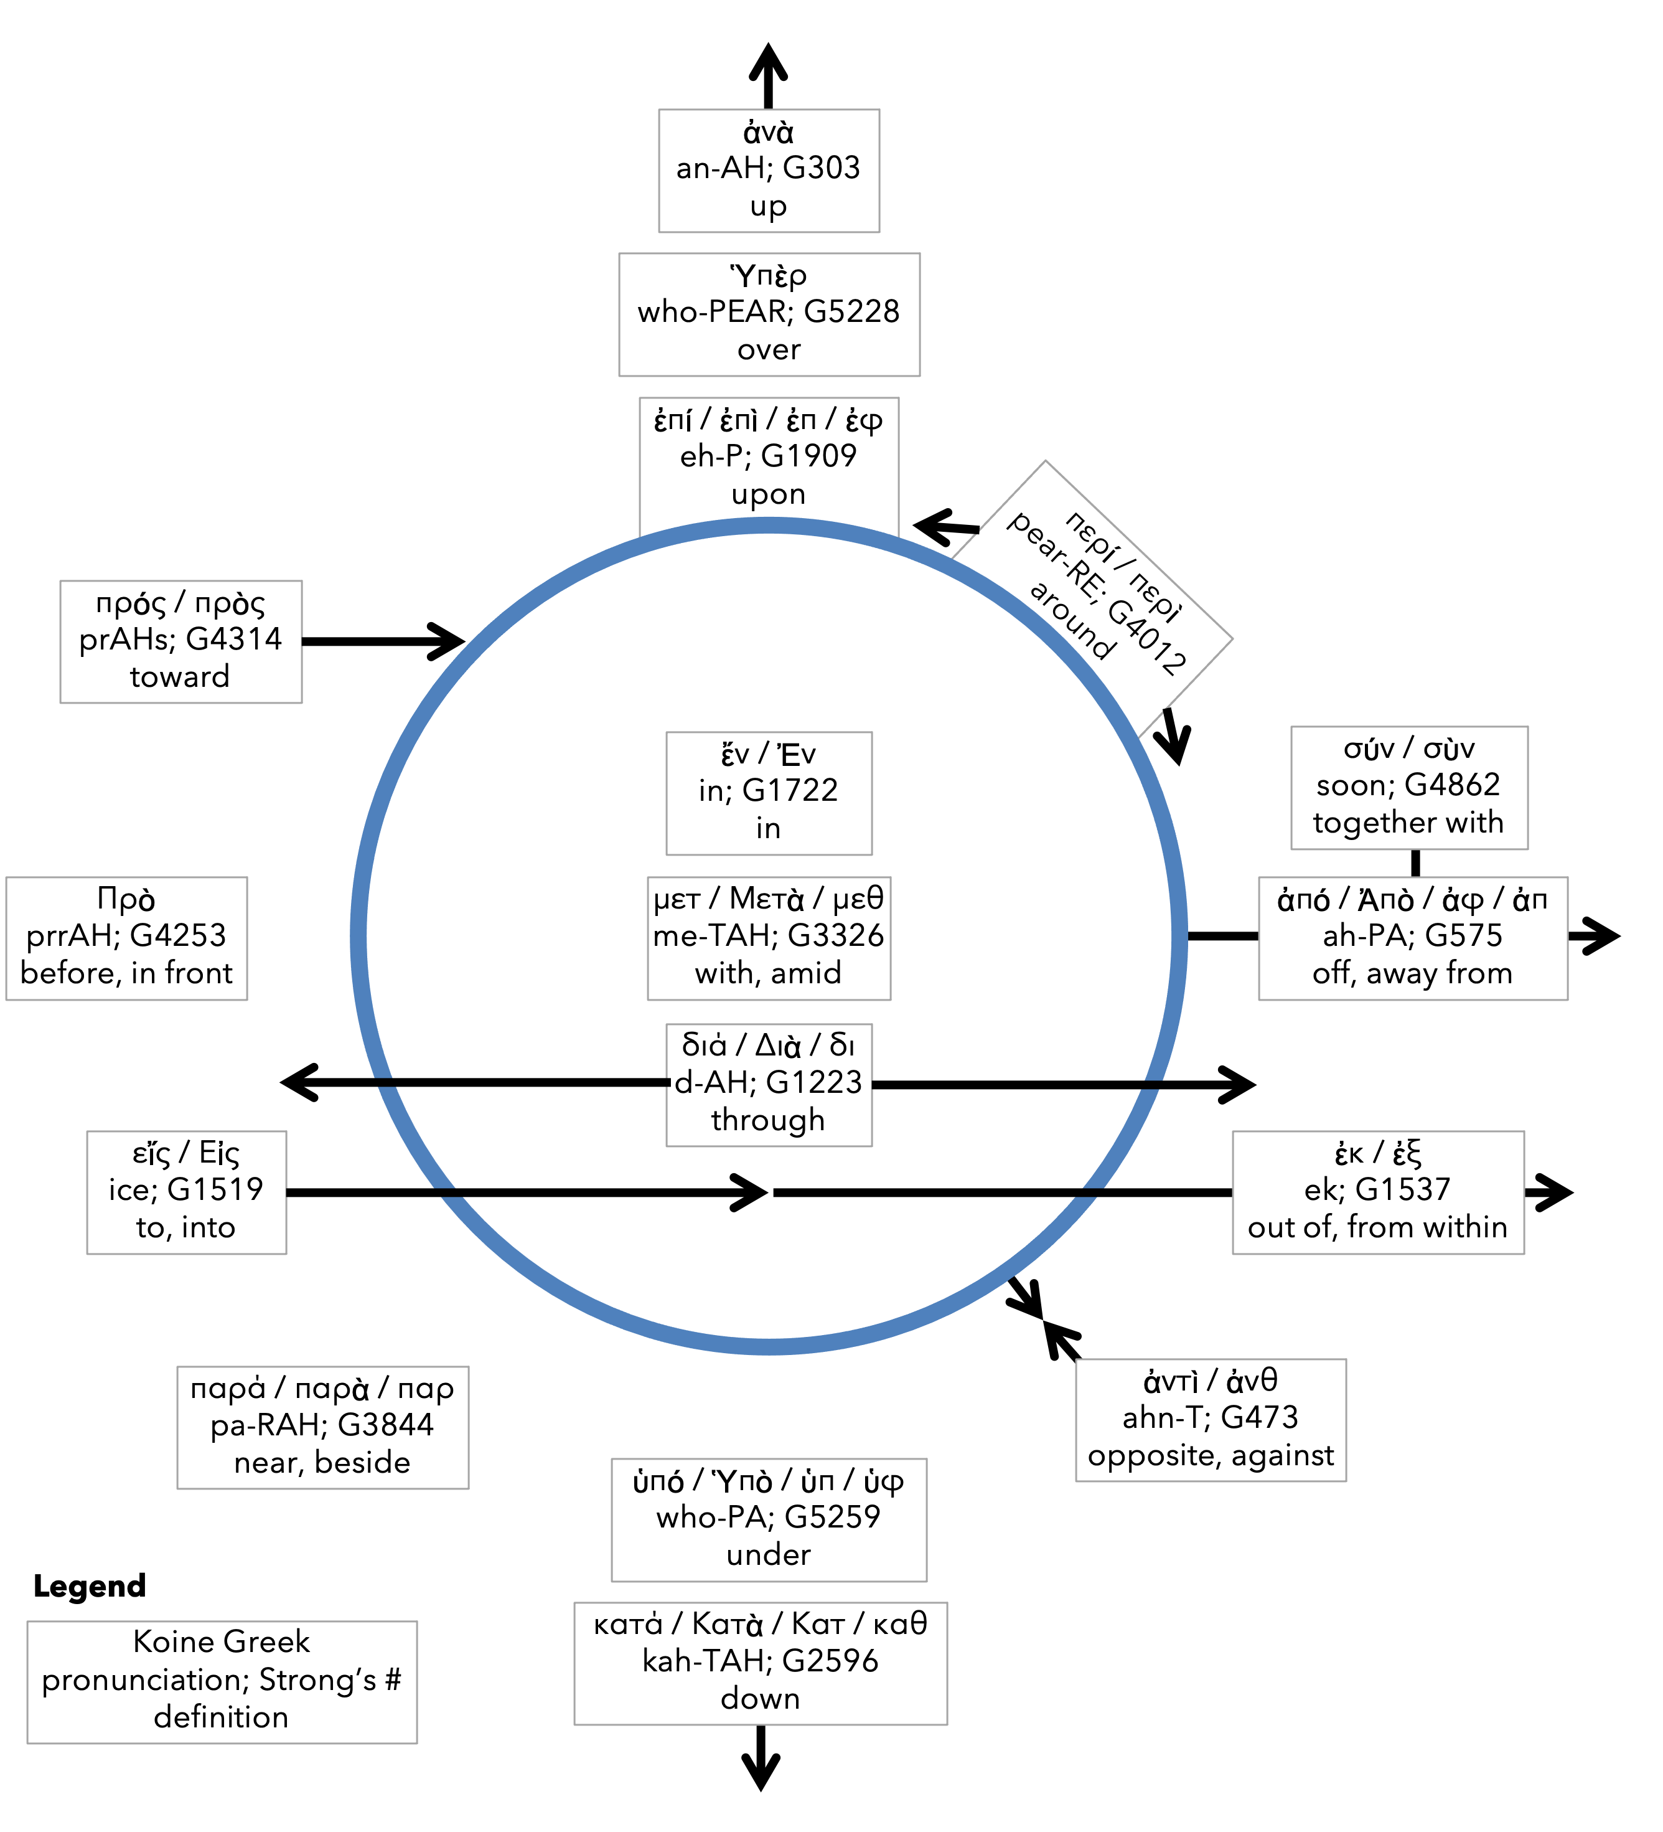
Preposition circle (page 11)

Slide 19
Dr. Gordon Fee …a distinguishable part of the whole, but as part of the whole, not above or outside it

Slide 20
Dr. G. Walter Hansen …a distinguishable part of the whole, but as part of the whole, not above or outside it

Slide 21
Dr. G. F. Hawthorne & Dr. Ralph P. Martin Paul can see it no other way: as the master was, so must the servant be.

Slide 22
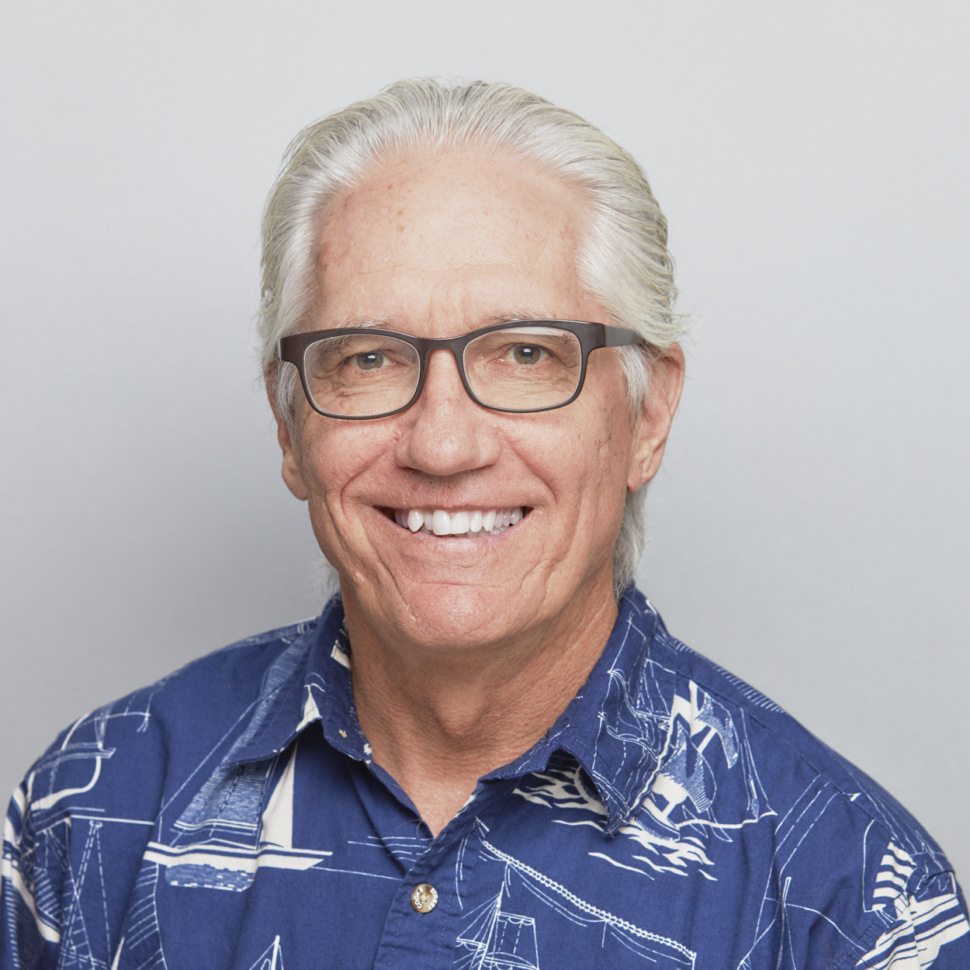
Dr. Joe Hellerman The pacification of the known world by the Romans was known as the pax Romana/ Augusta. The ideology of universal peace and prosperity

Slide 23
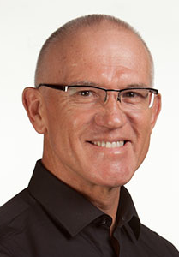
Dr. Mark Keown The pacification of the known world by the Romans was known as the pax Romana/ Augusta. The ideology of universal peace and prosperity under

Slide 24
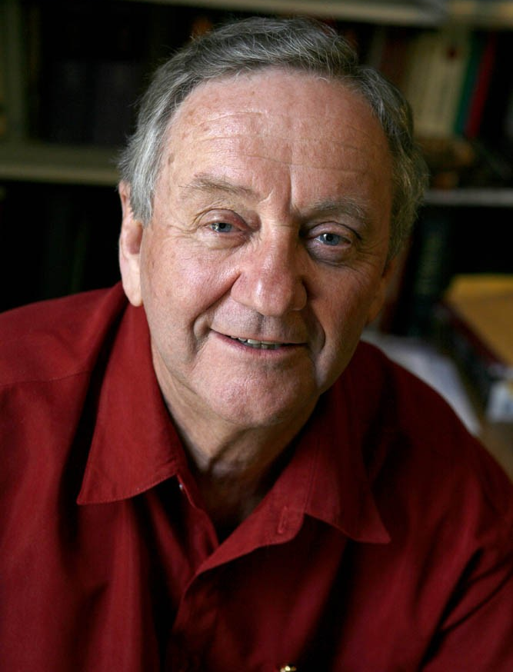
Dr. Peter T. O’Brien The pacification of the known world by the Romans was known as the pax Romana/ Augusta. The ideology of universal peace and prosperity under

Slide 25
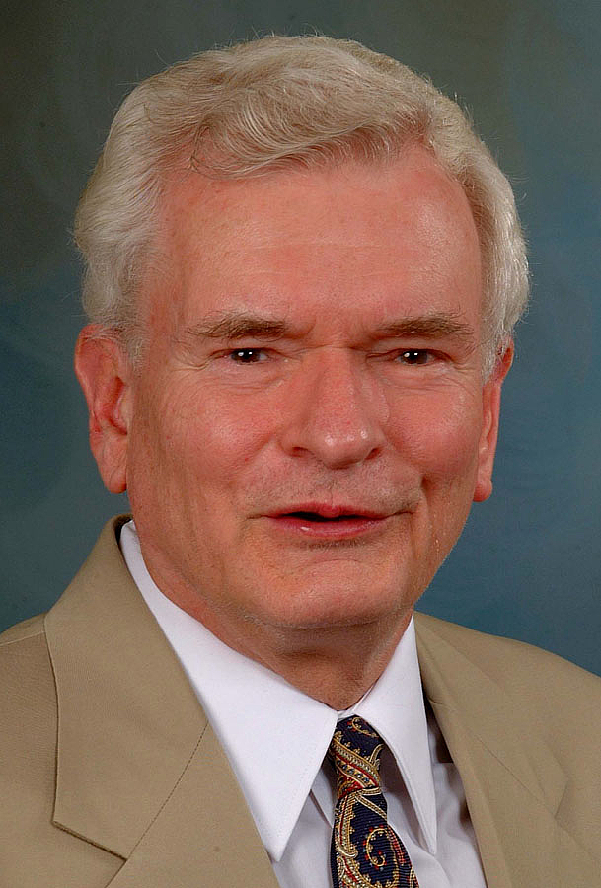
Dr. John Reumann Christ Jesus provides the basis for their relation to God, “glue” for their connections with each other, the sphere for their life and endeavors

Slide 26
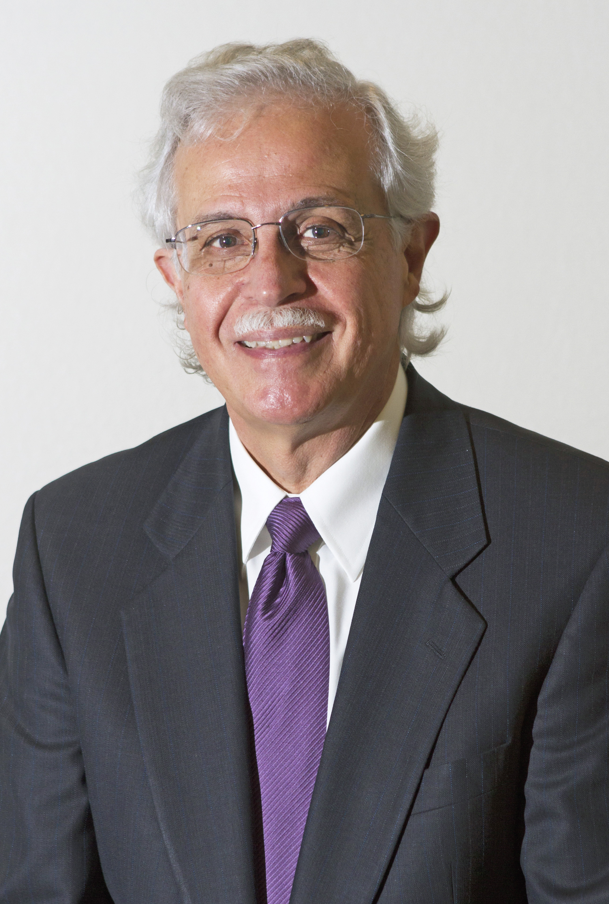
Dr. Moises Silva Christ Jesus provides the basis for their relation to God, “glue” for their connections with each other, the sphere for their life and endeavors

Slide 27
Jen Wilkin The heart cannot love what the mind does not know.

